Slide 1
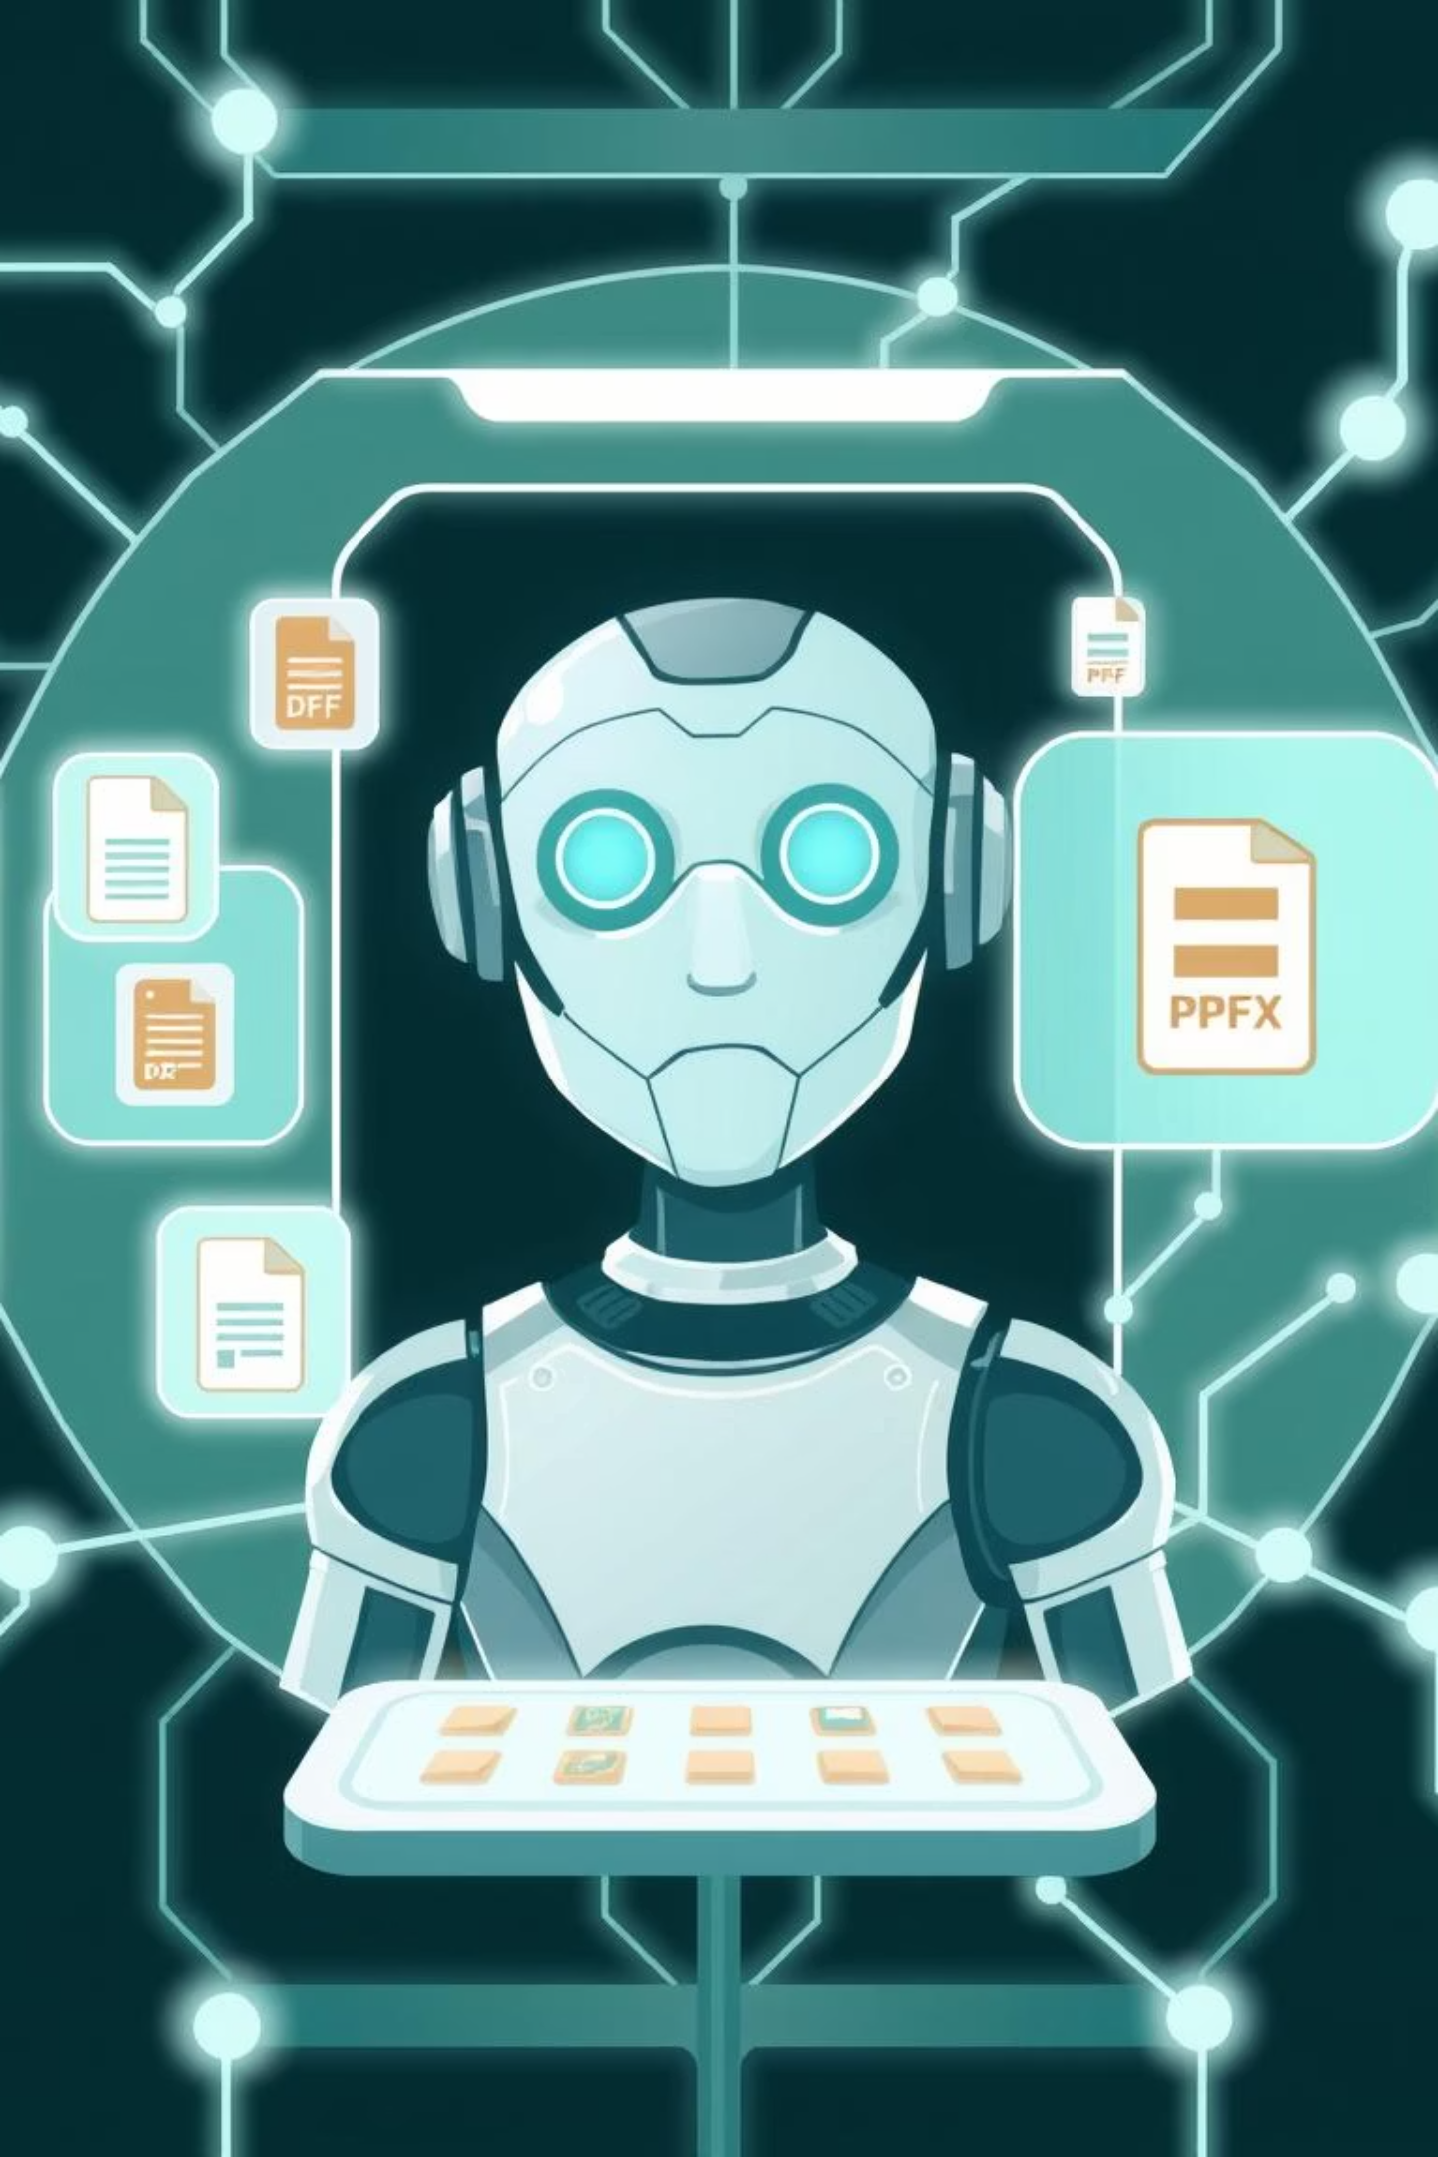
Agentic RAG Chatbot for Multi-Format Documents
Presented by Joshua Peter Polaprayil

Slide 2
📚 Project Overview & ✨ Features
Project Overview
Key Features
This project implements an advanced Retrieval-Augmented Generation (RAG) chatbot using a multi-agent architecture powered by Streamlit for the user interface. It's designed to interact with diverse document formats, providing accurate and contextually relevant answers by leveraging a persistent knowledge base.
Multi-Format Document Support: Ingests PDFs, DOCX, PPTX, CSV, TXT, and Markdown files.
Agent-Based Architecture: Uses a Coordinator Agent to orchestrate sub-agents for modular processing.
Model Context Protocol (MCP): Employs MCP for structured and efficient inter-agent communication.
Persistent Knowledge Base: FAISS vector store persists across sessions.
Source Citation & Clear Data: Enhances transparency and usability.

Slide 3
🏗️ Agent-Based Architecture with MCP
The core of this RAG chatbot is its agentic design, managed by a CoordinatorAgent which utilizes the Model Context Protocol (MCP) for structured communication between components.
1
2
CoordinatorAgent
IngestionAgent
Acts as the central hub, orchestrating messages, delegating tasks to sub-agents, and managing UI message queues.
Responsible for parsing diverse document formats, chunking content, and preparing it for embedding.
3
4
RetrievalAgent
LLMResponseAgent
Embeds document chunks, indexes them into the persistent FAISS vector store, and retrieves relevant context for queries.
Generates coherent answers using the LLM, leveraging retrieved context and conversation history.

Slide 4





System Communication Flow
UI
User interaction, document upload, query input, and response display.
CoordinatorAgent
Orchestrates requests and responses, dispatches messages via MCP.
IngestionAgent
Parses and chunks documents for processing.
RetrievalAgent
Embeds, stores in FAISS, and retrieves relevant information.
LLMResponseAgent
Generates final answers using the retrieved context.
The FAISS Store acts as the persistent knowledge base, accessed by the RetrievalAgent.

Slide 5





🛠️ Tech Stack
The project leverages a robust set of modern tools and libraries for efficient development and operation.
Python 3.9+
Streamlit UI
FAISS Vector Store
The core programming language for the entire backend agent system.
Powers the intuitive and interactive web-based user interface.
Used for efficient similarity search and persistent storage of embeddings.
Document Parsers
OpenAI / Google Gemini LLMs
Libraries like PyMuPDF, python-docx, python-pptx, and pandas handle diverse file formats.
Large Language Models are integrated for natural language understanding and generation.

Slide 6
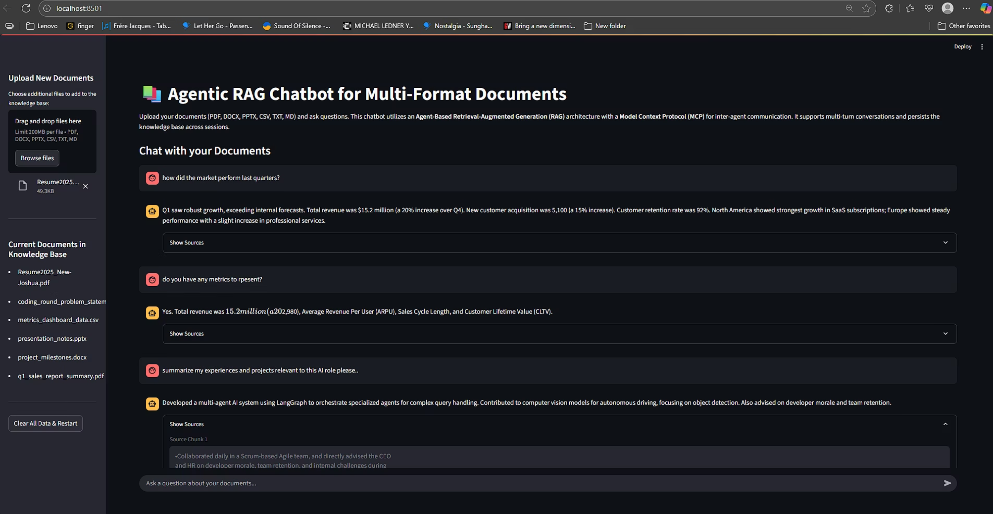
📸 Streamlit UI in Action
The user interface provides seamless interaction for uploading documents, querying the knowledge base, and viewing source citations for generated responses.

Slide 7
⚠️ Challenges & 🔮 Future Scope
Challenges Faced
Future Enhancements
Optimizing UI performance when handling very large documents.
Implementing asynchronous ingestion and querying for improved responsiveness.
Robustly handling diverse document formats, especially those with complex embedded content.
Extending RAG capabilities to include multi-modal data (images, audio, video).
Balancing retrieval latency with accuracy, particularly in real-time interactions.
Exploring cloud deployment strategies and user authentication for enterprise use.
Integrating comprehensive monitoring and evaluation metrics for performance tracking.

Slide 8

A Note on Presentation Delivery
I sincerely apologize that I am unable to prepare the requested 5-minute video presentation at this time. Due to concurrent commitments, including an active freelance project for a US-based firm involving another agentic chatbot, an ongoing LLM course, and a separate AI assessment challenge focused on OCR and extraction, my capacity is fully allocated. I really hope that this won't take me out of the contention for this role as I'm extremely excited about this.
I hope the detailed GML presentation effectively conveys the scope, architecture, and features of the Agentic RAG Chatbot project. Thank you for your understanding.
Thank you for your time and consideration.

